Slide 1
Dynamic Epistemic Logic​ Chapter 7, Completeness (7.3-7.8)​
Maria Markella Diamantopoulou​
«Applied Mathematical Sciences»
Spring Semester 2021

Slide 2
Overview
Reminder
Completeness for S5C
Completeness for PA without common knowledge
Completeness for PA with common knowledge
Completeness in a generalised form for logic of action model without common knowledge
Completeness in a generalised form for logic of action model with common knowledge
Introduction to relativised common knowledge

Slide 3
Reminder
The proof system S5

Slide 4
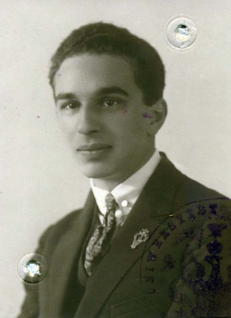
Definition 7.1 (Maximal consistent):
Let $Γ⊆ℒ_{K}$. $Γ$ is maximal consistent iff
$Γ$is consistent: $Γ⊬⊥$
$Γ$is maximal: there is no $Γ′⊆ℒ_{K}$ such that $Γ⊂Γ^{′}$and $Γ^{′}$is consistent.
Definition 7.2(Canonical model):
The canonical model $M^{c}=\left\langle S^{c},∼^{c},V^{c}\right\rangle$ is defined as follows:
$S^{c}$={$Γ$| $Γ$ is maximal consistent}
$Γ∼_{a}^{c}Δ iff \left\{K_{a}φ|K_{a}φ∈Γ\right\}=\left\{K_{a}φ|K_{a}φ∈Δ\right\}$
$V_{ p}^{c}=\left\{Γ∈S^{c}|p∈Γ\right\}$
Lemma 7.3(Lindenbaum):
Every consistent set of formulas is a subset of a maximal consistent set of formulas.

Slide 5
Definition (out of the book):
In mathematical logic, a set $T$ of logical formulas is deductively closed if it contains every formula $φ$ that can be logically deduced from $T$ formally if $T⊢φ$ always implies $φ∈T$.
Lemma 7.4:
If $Γ$ and $Δ$ are maximal consistent sets, then:
$Γ$ is deductively closed,
$φ∈Γ$ iff $¬φ∉Γ,$
$\left(φ∧ψ\right)∈Γ$ iff $φ∈Γ and ψ∈Γ$,
$Γ∼_{a}^{c}Δ iff \left\{K_{a}φ|K_{a}φ∈Γ\right\}⊆Δ$,
$\left\{K_{a}φ|K_{a}φ∈Γ\right\}⊢ψ$iff $\left\{K_{a}φ|K_{a}φ∈Γ\right\}⊢K_{a}ψ$.
Lemma 7.5(Truth):
For every ${φ∈ℒ}_{K}$ and every maximal consistent set $Γ:$
$φ∈Γ$ iff $\left(M^{c},Γ\right)⊨φ$
Lemma 7.6 (Canonicity):
The canonical model is reflexive, transitive and Euclidean.
Theorem 7.7 (Completeness) :
For every ${φ∈ℒ}_{K}$
$⊨φ$ implies $⊢φ$

Slide 6
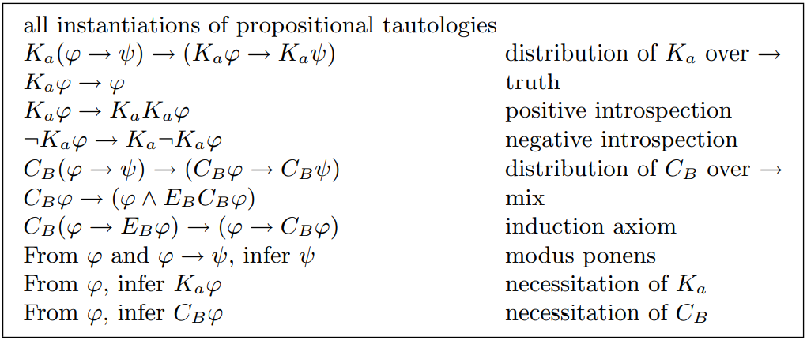
The proof system S5C

Slide 7
Definition 7.8(Closure):
Let $cl:ℒ_{KC}→℘\left(ℒ_{KC}\right)$, be the function such that for every ${φ∈ℒ}_{KC}$, $cl\left(φ\right)$ is the smallest set such that:
$φ∈cl(φ)$,
If $ψ∈cl(φ)$, then $Sub(ψ)⊆cl(φ)$ (where $Sub(ψ)$ is the set of subformulas of $ψ$),
If $ψ∈cl\left(φ\right)$ and $ψ$ is not a negation, then $¬ψ∈cl(φ)$,
If $C_{B}ψ∈cl\left(φ\right)$, then$\left\{K_{a}C_{B}ψ|a∈B\right\}⊆cl\left(φ\right)$.
Lemma 7.9:
$cl\left(φ\right)$ is finite for all formulas ${φ∈ℒ}_{KC}$.
Proof:
By induction to $φ$.
Base case: If $φ$ is a propositional variable $p$, then the closure of $φ$ is $\left\{p,¬p\right\}$, which is finite.
Induction hypothesis: $cl\left(φ\right)$ and $cl\left(ψ\right)$ are finite.
Induction step:
The case for $¬φ$: the closure of our case is the set $\left\{¬φ\right\}∪cl\left(φ\right)$. By induction hypothesis we know that $cl\left(φ\right)$ is finite so the set is also finite.
The case for $\left(φ∧ψ \right)$: the closure of our case is the set $\left\{\left(φ∧ψ \right)\text{,}¬\left(φ∧ψ \right)\right\}∪cl\left(φ\right)∪cl\left(ψ\right)$. By induction hypothesis $cl\left(φ\right)$ and $cl\left(ψ\right)$ are finite so our set is also finite.
The case for $K_{a}φ$: the closure of our case is the set $\left\{K_{a}φ,¬K_{a}φ\right\}∪cl\left(φ\right)$. By induction hypothesis we know that $cl\left(φ\right)$ is finite so our set is also finite.
The case for $C_{B}φ$: the closure of our case is the set $\left\{C_{B}φ,¬C_{B}φ\right\}∪\left\{K_{a}C_{B}φ,¬K_{a}C_{B}φ|a∈B\right\}∪cl\left(φ\right)$. By induction hypothesis we know that $cl\left(φ\right)$ is finite so our set is also finite. 

Slide 8
Definition 7.10(Maximal consistent in $Φ$):
Let $Φ⊆ℒ_{KC}$ be the closure of some formula. $Γ$ is maximal consistent in $Φ$ iff:
$Γ⊆Φ$
$Γ$is consistent: $Γ⊬⊥$
$Γ$is maximal: there is no $Γ′⊆ℒ_{K}$ such that $Γ⊂Γ^{′}$and $Γ^{′}$ is consistent.
Lemma 7.12 (Lindenbaum):
Let $Φ$ be the closure of some formula. Every consistent subset of $Φ$ is a subset of a maximal consistent set in $Φ$.
Proof:
Let $Δ⊆Φ$ be a consistent set of formulas. Let $\left|Φ\right|=n$. Let $φ_{k}$ be the $k$-th formula in an enumeration of $Φ$. We consider the sequence of sets of formulas as follows:
$$Γ_{0}=Δ$$
$$Γ_{k+1}=\left\{\begin{aligned}Γ_{k}∪\left\{φ_{k+1}\right\}, if Γ_{k}∪\left\{φ_{k+1}\right\} is consistent \\ Γ_{k} , otherwise\end{aligned}\right.$$
We can see that $Δ⊆Γ_{n}$.What we need to show?
We need to show that $Γ_{n}$ is maximal consistent. In order to see that $Γ_{n}$ is consistent we will prove that $Γ_{k}$ is consistent by induction on $k$, which means that $Γ_{n}$ is also consistent.

Slide 9
Proof :
By assumption $Γ_{0}$is consistent due to Δ is a consistent set of formulas. We can also see that if $Γ_{k}$is consistent then $Γ_{k+1}$ is consistent. Thus we prove that$Γ_{n}$ is consistent 
To see that $Γ_{n}$ is maximal in $Φ,$take an arbitrary formula${ φ}_{k}∈Φ$ such that $φ_{k}∉Γ_{n}$. Then $φ_{k}∉Γ_{k}$ too. Therefore $Γ_{k}∪\left\{φ_{k}\right\}$ is inconsistent and so $Γ_{n}∪\left\{φ_{k}\right\}$ is inconsistent too. Since ${ φ}_{k}$ was arbitrary there is no $Γ′⊆Φ$ such that $Γ_{n}⊂Γ^{′}$and $Γ^{′}$ is consistent. 
Definition 7.11(Canonical model for $Φ$):
Let $Φ$ be the closure of some formula. The canonical model $M^{c}=\left\langle S^{c},∼^{c},V^{c}\right\rangle$ is defined as follows:
$S^{c}$={$Γ$| $Γ$ is maximal consistent in $Φ$}
$Γ∼_{a}^{c}Δ iff \left\{K_{a}φ|K_{a}φ∈Γ\right\}=\left\{K_{a}φ|K_{a}φ∈Δ\right\}$
$V_{ p}^{c}=\left\{Γ∈S^{c}|p∈Γ\right\}$
 We construct a finite model for only a finite fragment of the language depending on the formula we are interested in.

Slide 10
Definition 7.13(Paths):
A B-path from $Γ$ is a sequence $Γ_{0},…,Γ_{n}$ of maximal consistent sets in $Φ$ such that for all $k$ $\left(0≤k<n\right)$ there is an agent $a∈B$ such that $Γ_{k}∼_{a}^{c}Γ_{k+1}$ and $Γ_{0}=Γ$.
A $φ$-path is a sequence $Γ_{0},…,Γ_{n}$ of maximal consistent sets in $Φ$ such that for all $k$ $\left(0≤k<n\right)$ $φ∈Γ_{k}$.
Note: We take the length of a path $Γ_{0},…,Γ_{n}$ to be $n$.
Lemma 7.14:
Let $Φ$ be the closure of some formula. Let $M^{c}=\left(S^{c},∼^{c},V^{c}\right)$ be the canonical model for $Φ$. If $Γ$ and $Δ$ are maximal consistent sets, then:
$Γ$ is deductively closed in $Φ$ (for all formulas $φ∈Φ$, if $⊢\underline{Γ}→φ$, then $φ∈Γ$. Note that $\underline{Γ}=\bigwedge{Γ}$)
If $¬φ∈Φ$, then $φ∈Γ$ iff $¬φ∉Γ$
If $\left(φ∧ψ\right)∈Φ$, then $\left(φ∧ψ\right)∈Γ$ iff $φ∈Γ$ and $ψ∈Γ$
If $\underline{Γ}∧\hat{K_{a}}\underline{Δ}$ is consistent, then $Γ∼_{a}^{c}Δ$
If $K_{a}ψ∈Φ$, then $\left\{K_{a}φ|K_{a}φ∈Γ\right\}⊢ψ$iff $\left\{K_{a}φ|K_{a}φ∈Γ\right\}⊢K_{a}ψ$
If${ C}_{B}φ∈Φ$, then ${ C}_{B}φ∈Γ$ iff every B-path from $Γ$ is a $φ$-path.

Slide 11
In other case, it doesn’t hold that $Γ is maximal consistent set inΦ$
by the definition of maximal consistent set
Exercise 7.15
Proof :
Suppose that $φ∈Φ$. Suppose that $Γ⊢φ$. We know by assumption that $Γ$ is maximal consistent which means that $Γ$ is consistent and maximal in $Φ$. Because of consistency of $Γ$ in $Φ$, $Γ∪\left\{φ\right\}$ is also consistent. Therefore, by maximality of $Γ$ in $Φ$, it must be the case that $φ∈Γ$.
Suppose $¬φ∈Φ$. Therefore $φ∈Φ.$
$"⇒"$ Suppose that $φ∈Γ$ then by consistency $¬φ∈Γ$
$"⇐"$ Suppose that $¬φ∉Γ$. By maximality, $Γ∪\left\{¬φ\right\}$ is inconsistent. Therefore $Γ⊢φ$and by the item 1 of this Lemma, $φ∈Γ$.
Suppose that $\left(φ∧ψ\right)∈Φ$.
$"⇒"$ Suppose that$\left(φ∧ψ\right)∈Γ$. Then $Γ⊢φ$ and $Γ⊢ψ$. Since $Φ$is closed, also $φ∈Φ$and $ψ∈Φ$. Therefore $φ∈Γ$ and $ψ∈Γ$ by the item 1 of this Lemma.
$"⇐"$ Suppose that $φ∈Γ$ and $ψ∈Γ$ . Therefore $Γ⊢\left(φ∧ψ\right)$ and by the item 1 of this Lemma $\left(φ∧ψ\right)∈Γ$.

Slide 12
Lemma 7.17 (Truth):
Let $Φ$ be the closure of some formula. Let $M^{c}=\left(S^{c},∼^{c},V^{c}\right)$ be the canonical model for $Φ$. For all $Γ∈S^{c}$ and all $φ∈Φ$:
$φ∈Γ$ iff $\left(M^{c},Γ\right)⊨φ$
Proof: Suppose that $φ∈Φ$
Base case: Suppose that $φ$ is a propositional variable $p$. Then by the definition of $V^{c}$, $p∈Γ$ iff $Γ∈S^{c}$ which by semantics is equivalent to $\left(M^{c},Γ\right)⊨p$.
Induction hypothesis: For every maximal consistent set $Γ$,
$φ∈Γ$ iff $\left(M^{c},Γ\right)⊨φ$.
Induction step:
The case for $¬φ$: $¬φ∈Γ$is equivalent to $φ∉Γ$ by the item 2 in Lemma 7.14. By induction hypothesis and the semantics this is equivalent to
$\left(M^{c},Γ\right)⊨¬φ$.
The case for $\left(φ∧ψ\right)$: $\left(φ∧ψ\right)∈Γ$ is equivalent to $φ∈Γ$ and $ψ∈Γ$ by the item 3 of Lemma 7.14 . By induction hypothesis this is equivalent to $\left(M^{c},Γ\right)⊨φ$ and
$\left(M^{c},Γ\right)⊨ψ$ which by semantics is equivalence to $\left(M^{c},Γ\right)⊨$ $\left(φ∧ψ\right)$.
The case for $K_{a}φ$:
Suppose that $K_{a}φ∈Γ$.Take an arbitrary maximal consistent set $Δ$ in $Φ$. Suppose that $Γ∼_{a}^{c}Δ$ , so $K_{a}φ∈Δ$ by the definition of the relation $∼_{a}^{c}$. Since $⊢K_{a}φ→φ$ by the truth, and $Δ$ is deductively closed (due to $Δ$ is maximal consistent and by the item 1 in Lemma 7.14) then $φ∈Δ.$By the induction hypothesis, this is equivalent to $\left(M^{c},Δ\right)⊨φ$ . Since we chose an arbitrary $Δ$ , then $\left(M^{c},Δ\right)⊨φ$ holds for all $Δ$ such that $Γ∼_{a}^{c}Δ$. Therefore by semantics this is equivalence to $\left(M^{c},Γ\right)⊨K_{a}φ$.
2. If $¬φ∈Φ$, then $φ∈Γ$ iff $¬φ∉Γ$
3. If $\left(φ∧ψ\right)∈Φ$, then $\left(φ∧ψ\right)∈Γ$ iff $φ∈Γ$ and $ψ∈Γ$
Truth: $K_{a}φ→φ$

Slide 13
The case for $C_{B}φ$: Suppose that $C_{B}φ∈Γ$. From item 6 in Lemma 7.14 this is the case iff every B-path from $Γ$ is a $φ$-path. By induction hypothesis, this is the case that iff every B-path along $φ$is true. Therefore by semantics this is equivalence to $\left(M^{c},Γ\right)⊨C_{B}φ$. 
Lemma 7.18(Canonicity):
Let $Φ$ be the closure of some formula. The canonical model for $Φ$is reflexive, transitive and Euclidean.
Proof:
The same as the proof of Lemma 7.6 which follows straightforwardly from the definition of the relation $∼_{a}^{c}$.
Theorem 7.19 (Completeness):
For every ${φ∈ℒ}_{KC}$
$⊨φ$ implies $⊢φ$
Proof:
We will prove this theorem by contraposition. Thus we suppose that $⊬φ$. Therefore $\left\{¬φ\right\}$ is a consistent set. By the Lindenbaum Lemma $\left\{¬φ\right\}$ is a subset of some $Γ$ which is maximal consistent in $cl\left(¬φ\right)$. Let $M^{c}$ be the canonical model for $cl\left(¬φ\right)$. By the Truth Lemma $\left(M^{c},Γ\right)⊨¬φ$. Therefore ⊭$φ$.

Slide 14
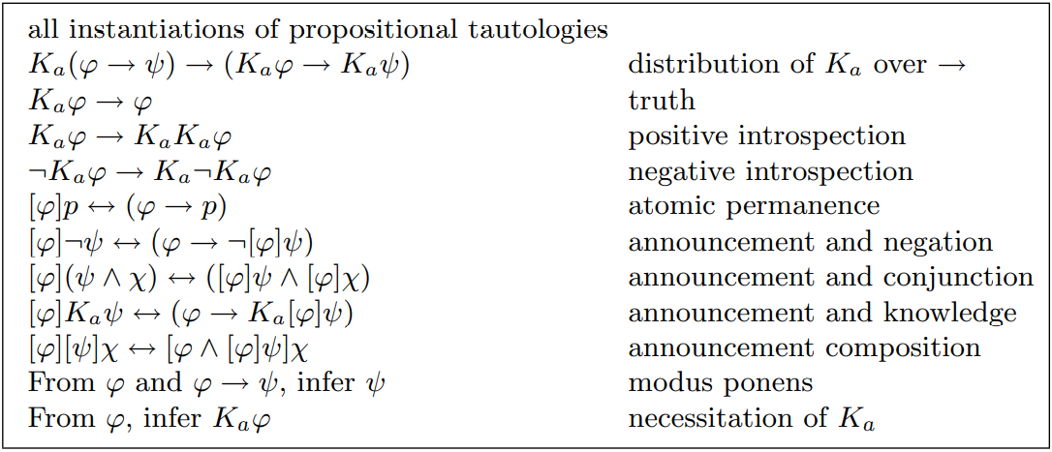
The proof system PA:

Slide 15
Definition 7.20 (Translation):
The translation $t:ℒ_{K[]}→ℒ_{K}$ is defined as follows:
$$t\left(p\right)=p$$
$$t\left(¬φ\right)=¬t\left(φ\right)$$
$t\left(φ∧ψ\right)=$ $t\left(φ)∧t(ψ\right)$
$$t\left(K_{a}φ \right)=K_{a}t\left(φ\right)$$
$$t\left(\left[φ\right]p\right)=t\left(φ→p\right)$$
$$t\left(\left[φ\right]¬ψ\right)=t\left(φ→¬\left[φ\right]ψ\right)$$
$$t\left(\left[φ\right]\left(ψ∧χ\right)\right)=t\left(\left[φ\right]\left(ψ)∧\left[φ\right]χ\right)\right)$$
$$t\left(\left[φ\right]K_{a}ψ\right)=t\left(φ→K_{a}\left[φ\right]ψ\right)$$
$$t\left(\left[φ\right]\left[ψ\right]χ\right)=t\left(\left[φ∧\left[φ\right]ψ\right]χ\right)$$
Definition 7.21 (Complexity):
The complexity $c :ℒ_{K[]}→ℕ$ is defined as follows:
$$c\left(p\right)=1$$
$$c\left(¬φ\right)=1+c\left(φ\right)$$
$c\left(φ∧ψ\right)=1+\max_{}\left(c\left(φ\right),c\left(ψ\right)\right)$
$$c\left(K_{a}φ\right)=1+c\left(φ\right)$$
$$c\left(\left[φ\right]ψ\right)=\left(4+c\left(φ\right)\right)∙c\left(ψ\right)$$
Where $p$ is a propositional variable, $φ$ and $ψ$ are formulas

Slide 16
Lemma 7.22:
For all $φ,ψ$ and $χ$:
$c\left(ψ\right)≥c\left(φ\right)$ if $φ∈Sub\left(ψ\right)$
$c\left(\left[φ\right]p\right)>c\left(φ→p\right)$
$c\left(\left[φ\right]¬ψ\right)>c\left(φ→¬\left[φ\right]ψ\right)$
$c\left(\left[φ\right]\left(ψ∧χ\right)\right)>c\left(\left[φ\right]ψ∧\left[φ\right]χ\right)$
$c\left(\left[φ\right]K_{a}ψ\right)>c\left(φ→K_{a}\left[φ\right]ψ\right)$
$c\left(\left[φ\right]\left[ψ\right]χ\right)>c\left(\left[φ∧\left[φ\right]ψ\right]χ\right)$
Exercise 7.23:
Prove Lemma 7.22
$Sub(ψ)$ is the set of subformulas of $ψ$

Slide 17
2. $c\left(\left[φ\right]p\right)>c\left(φ→p\right)$
Proof: ??
$$c\left(\left[φ\right]p\right)=\left(4+c\left(φ\right)\right)=4+c\left(φ\right)$$
And
$$c\left(φ→p\right)=c\left(¬φ∨p \right)$$
$=c\left(¬\left(φ∧¬p\right)\right)$
$=1+c\left(φ∧¬p\right)$
$=2+\max_{}\left(c\left(φ\right),2 \right)$
So $c\left(\left[φ\right]p\right)>c\left(φ→p\right)$
3. $c\left(\left[φ\right]¬ψ\right)>c\left(φ→¬\left[φ\right]ψ\right)$
Proof:??
$$c\left(\left[φ\right]¬ψ\right)=\left(4+c\left(φ\right)\right)∙c\left(¬ψ\right)=\left(4+c\left(φ\right)\right)∙\left(1+c\left(ψ\right)\right)=4+c\left(φ\right)+4c\left(ψ\right)+c\left(φ\right)∙c\left(ψ\right)$$
And
$$c\left(φ→¬\left[φ\right]ψ\right)=c\left(¬φ∨\left(¬\left[φ\right]ψ\right)\right)=c\left(¬\left(φ∧¬\left(¬\left[φ\right]ψ\right)\right)\right)=1+c\left(φ∧¬\left(¬\left[φ\right]ψ\right)\right)=$$
Reminder:
$$c\left(p\right)=1$$
$$c\left(¬φ\right)=1+c\left(φ\right)$$
$c\left(φ∧ψ\right)=1+\max_{}\left(c\left(φ\right),c\left(ψ\right)\right)$
$$c\left(K_{a}φ\right)=1+c\left(φ\right)$$
$$c\left(\left[φ\right]ψ\right)=\left(4+c\left(φ\right)\right)∙c\left(ψ\right)$$
The abbriviation of $\left(φ→p \right) i$s $\left(¬φ∨p \right)$

Slide 18
Reminder:
$$c\left(p\right)=1$$
$$c\left(¬φ\right)=1+c\left(φ\right)$$
$c\left(φ∧ψ\right)=1+\max_{}\left(c\left(φ\right),c\left(ψ\right)\right)$
$$c\left(K_{a}φ\right)=1+c\left(φ\right)$$
$$c\left(\left[φ\right]ψ\right)=\left(4+c\left(φ\right)\right)∙c\left(ψ\right)$$
$$=1+c\left(φ∧¬\left(¬\left[φ\right]ψ\right)\right)$$
$$=1+1+\max_{}\left(c\left(φ\right),c\left(¬\left(¬\left[φ\right]ψ\right)\right)\right)$$
$$=2+\max_{}\left(c\left(φ\right),+c\left(¬\left[φ\right]ψ\right)\right)$$
$$=2+\max_{}\left(c\left(φ\right),2+c\left(\left[φ\right]ψ\right)\right)$$
$$=2+\max_{}\left(c\left(φ\right),2+\left(4+c\left(φ\right)\right)∙c\left(ψ\right)\right)$$
$$=2+\max_{}\left(c\left(φ\right),2+\left(4c\left(ψ\right)+c\left(φ\right)c\left(ψ\right)\right)\right)$$
$$2+\max_{}\left(c\left(φ\right),2+4c\left(ψ\right)+c\left(φ\right)c\left(ψ\right)\right)$$
Thus $c\left(\left[φ\right]¬ψ\right)>c\left(φ→¬\left[φ\right]ψ\right)$.
4. $c\left(\left[φ\right]\left(ψ∧χ\right)\right)>c\left(\left[φ\right]ψ∧\left[φ\right]χ\right)$
Proof:??
Assume without loss of generality, that $c\left(ψ\right)≥c\left(χ\right)$. Then :
$$c\left(\left[φ\right]\left(ψ∧χ\right)\right)=\left(4+c\left(φ\right)\right)∙c\left(ψ∧χ\right)=\left(4+c\left(φ\right)\right)\left(1+\max_{}\left(c\left(ψ\right),c\left(χ\right)\right)\right)$$
$$=\left(4+c\left(φ\right)\right)\left(1+c\left(ψ\right)\right)=4+4c\left(ψ\right)+c\left(φ\right)+c\left(φ\right)c\left(ψ\right)$$

Slide 19
And
$$c\left(\left[φ\right]ψ∧\left[φ\right]χ\right)$$
$$=1+\max_{}\left(\left(4+c\left(φ\right)\right)c\left(ψ\right),\left(4+c\left(φ\right)\right)c\left(χ\right)\right)$$
$$=1+\left(\left(4+c\left(φ\right)\right)c\left(ψ\right)\right)$$
$$=1+4c\left(ψ\right)+c\left(φ\right)c\left(ψ\right)$$
So $c\left(\left[φ\right]\left(ψ∧χ\right)\right)>c\left(\left[φ\right]ψ∧\left[φ\right]χ\right).$
6. $c\left(\left[φ\right]\left[ψ\right]χ\right)>c\left(\left[φ∧\left[φ\right]ψ\right]χ\right)$
Proof:??
$$c\left(\left[φ\right]\left[ψ\right]χ\right)=\left(4+c\left(φ\right)\right)\left(4+c\left(ψ\right)\right)c\left(χ\right)$$
$$=\left(16+4c\left(φ\right)+4c\left(ψ\right)+c\left(φ\right)c\left(ψ\right)c\left(χ\right)\right)$$
And
$$c\left(\left[φ∧\left[φ\right]ψ\right]χ\right)=\left(4+\left(1+\max_{}\left(c\left(φ\right), \left(4+c\left(φ\right)\right)c\left(ψ\right)\right)\right)\right)c\left(χ\right)$$
$$=\left(5+\left(\left(4+c\left(φ\right)\right)c\left(ψ\right)\right)\right)c\left(χ\right)$$
$=\left(5+4c\left(ψ\right)+c\left(φ\right)c\left(ψ\right)c\left(χ\right)\right)$ 
Reminder:
$$c\left(p\right)=1$$
$$c\left(¬φ\right)=1+c\left(φ\right)$$
$c\left(φ∧ψ\right)=1+\max_{}\left(c\left(φ\right),c\left(ψ\right)\right)$
$$c\left(K_{a}φ\right)=1+c\left(φ\right)$$
$$c\left(\left[φ\right]ψ\right)=\left(4+c\left(φ\right)\right)∙c\left(ψ\right)$$

Slide 20
We will show that every formula is provably equivalent to its translation.
Lemma 7.24:
For all formulas ${φ∈ℒ}_{K[]}$ it is the case that
$⊢φ↔t\left(φ\right)$
Proof:
We will prove this Lemma by induction on $c\left(φ\right)$.
Base case: If $φ$ is a propositional variable $p$, it’s trivial that $⊢p↔t\left(p\right)=p$.
Induction hypothesis: For all $φ$ such that $c\left(φ\right)≤n:$ $⊢φ↔t\left(φ\right)$.
Induction step: The case for $¬, ∧,$ $K_{a}$ follows straightforwardly from the induction hypothesis and item 1 of Lemma 7.22.
The case for$\left[φ\right]p$: This case follows straightforwardly from the atomic permanence axiom, item 2 of Lemma 7.22 and the induction hypothesis.
atomic permanence axiom: $\left[φ\right]p↔\left(φ→p\right)$
Item 2 of Lemma 7.22
$$c\left(\left[φ\right]p\right)>c\left(φ→p\right)$$

Slide 21
The case for$\left[φ\right]¬ψ$: This case follows straightforwardly from the announcement and negation axiom, item 3 of Lemma 7.22 and the induction hypothesis
The case for$\left[φ\right]\left(φ∧ψ\right)$: This case follows straightforwardly from the announcement and conjunction axiom, item 4 of Lemma 7.22 and the induction hypothesis.
The case for$\left[φ\right]$ $K_{a}ψ$: This case follows straightforwardly from the announcement and knowledge axiom, item 5 of Lemma 7.22 and the induction hypothesis.
The case for$\left[φ\right]\left[ψ\right]χ$: This case follows straightforwardly from the announcement composition axiom, item 6 of Lemma 7.22 and the induction hypothesis.
3. $c\left(\left[φ\right]¬ψ\right)>c\left(φ→¬\left[φ\right]ψ\right)$
4. $c\left(\left[φ\right]\left(ψ∧χ\right)\right)>c\left(\left[φ\right]ψ∧\left[φ\right]χ\right)$
5. $c\left(\left[φ\right]K_{a}ψ\right)>c\left(φ→K_{a}\left[φ\right]ψ\right)$
6. $c\left(\left[φ\right]\left[ψ\right]χ\right)>c\left(\left[φ∧\left[φ\right]ψ\right]χ\right)$
$$\left[φ\right]¬ψ↔φ→¬\left[φ\right]ψ$$
$\left[φ\right]\left(ψ∧χ\right)↔\left[φ\right]ψ∧\left[φ\right]χ$
$\left[φ\right]K_{a}ψ↔φ→K_{a}\left[φ\right]ψ$
$\left[φ\right]\left[ψ\right]χ↔\left[φ∧\left[φ\right]ψ\right]χ$

Slide 22
Theorem 7.26 (Completeness):
For every ${φ∈ℒ}_{K[]}$ $⊨φ$ implies $⊢φ$
Proof:
Suppose that $⊨φ$ . Therefore $⊨t\left(φ\right)$ (by soundness) and by Lemma 7.24 holds that $⊢φ↔t\left(φ\right)$. Because of the fact that $t\left(φ\right)$ doesn’t contain any announcement operators, $S5⊢t\left(φ\right)$ (Theorem 7.7) We also have that $PA⊢t\left(φ\right)$ as $S5$ is subsystem of $PA$. Since $PA⊢φ↔t\left(φ\right)$, it follows that $PA⊢φ$.


Slide 23
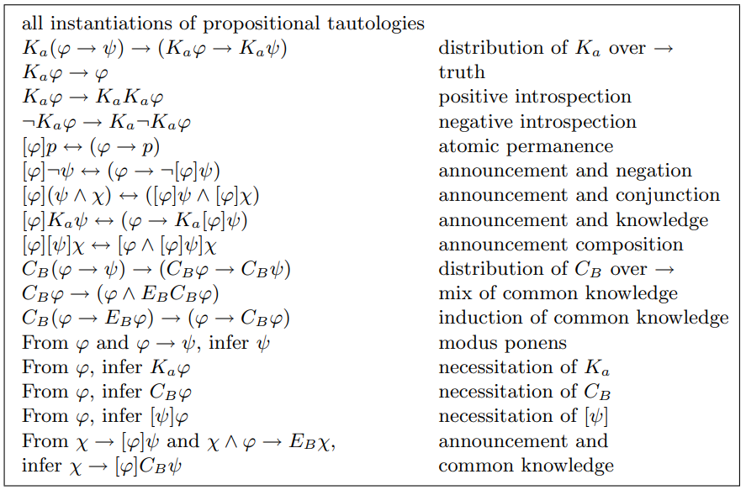
The proof system PAC

Slide 24
Definition 7.27 (Closure):
Let $cl:ℒ_{KC[]}→℘\left(ℒ_{KC[]}\right)$, be the function such that for every ${φ∈ℒ}_{KC[]}$, $cl\left(φ\right)$ is the smallest set such that:
$φ∈cl(φ)$,
If $ψ∈cl(φ)$, then $Sub(ψ)⊆cl(φ)$ (where $Sub(ψ)$ is the set of subformulas of $ψ$),
If $ψ∈cl\left(φ\right)$ and $ψ$ is not a negation, then $¬ψ∈cl(φ)$,
If $C_{B}ψ∈cl\left(φ\right)$, then$\left\{K_{a}C_{B}ψ|a∈B\right\}⊆cl\left(φ\right)$,
If $\left[ψ\right]p∈cl\left(φ\right)$, then $\left(ψ→p\right)∈cl\left(φ\right)$,
If $\left[ψ\right]¬χ∈cl\left(φ\right)$, then $\left(ψ→¬\left[ψ\right]χ\right)∈cl\left(φ\right)$,
If $\left[ψ\right]\left(χ∧ξ\right)∈cl\left(φ\right)$, then $\left(\left[ψ\right]χ∧\left[ψ\right]ξ\right)∈cl\left(φ\right)$,
If $\left[ψ\right]K_{a}χ∈cl\left(φ\right)$, then $\left(ψ→K_{a}\left[ψ\right]χ\right)∈cl\left(φ\right)$,
If $\left[ψ\right]C_{B}χ∈cl\left(φ\right)\text{, }\text{then} \left[ψ\right]χ∈cl\left(φ\right) and \left\{K_{a}{\left[ψ\right]C}_{B}χ|a∈B\right\}⊆cl\left(φ\right)\text{,}$
If $\left[ψ\right]\left[χ\right]ξ∈cl\left(φ\right)\text{, }\text{then}$ $\left[ψ∧\left[ψ\right]χ\right]ξ$ $∈cl\left(φ\right)$.

Slide 25
Lemma 7.28:
$cl\left(φ\right)$ is finite for all formulas ${φ∈ℒ}_{KC[]}$.
Lemma 7.29 (Lindenbaum):
Let $Φ$ be the closure of some formula. Every consistent subset of $Φ$ is a subset of a maximal consistent set in $Φ$.
Proof:
The same as Lemma 7.12
Definition 7.30 ($B$-$φ$-path):
A $B$-$φ$-path from$Γ$ is a $B$-path that is also $φ$-path.
Lemma 7.31:
Let $Φ$ be the closure of some formula. Let $M^{c}=\left(S^{c},∼^{c},V^{c}\right)$ be the canonical model for $Φ$. If $Γ$ and $Δ$ are maximal consistent sets, then:
$Γ$ is deductively closed in $Φ$ (for all formulas $φ∈Φ$, if $⊢\underline{Γ}→φ$, then $φ∈Γ$. Note that $\underline{Γ}=\bigwedge{Γ}$)
If $¬φ∈Φ$, then $φ∈Γ$ iff $¬φ∉Γ$
If $\left(φ∧ψ\right)∈Φ$, then $\left(φ∧ψ\right)∈Γ$ iff $φ∈Γ$ and $ψ∈Γ$
If $\underline{Γ}∧\hat{K_{a}}\underline{Δ}$ is consistent, then $Γ∼_{a}^{c}Δ$
If $K_{a}ψ∈Φ$, then $\left\{K_{a}φ|K_{a}φ∈Γ\right\}⊢ψ$iff $\left\{K_{a}φ|K_{a}φ∈Γ\right\}⊢K_{a}ψ$
If${ C}_{B}φ∈Φ$, then ${ C}_{B}φ∈Γ$ iff every B-path from $Γ$ is a $φ$-path.
If $\left[φ\right]C_{B}ψ∈Φ\text{, }\text{then} { \left[φ\right]C}_{B}ψ∈Γ \text{iff} \text{every} \text{B}\text{−}\text{path} \text{from} Γ \text{is} \text{a} \left[φ\right]ψ\text{−}\text{path}\text{.}$

Slide 26
Definition 7.32 (Complexity):
The complexity $c :ℒ_{KC[]}→ℕ$ is defined as follows:
$$c\left(p\right)=1$$
$$c\left(¬φ\right)=1+c\left(φ\right)$$
$c\left(φ∧ψ\right)=1+\max_{}\left(c\left(φ\right),c\left(ψ\right)\right)$
$$c\left(K_{a}φ\right)=1+c\left(φ\right)$$
$$c\left(C_{B}φ\right)=1+c\left(φ\right)$$
$$c\left(\left[φ\right]ψ\right)=\left(4+c\left(φ\right)\right)∙c\left(ψ\right)$$
Lemma 7.33:
For all $φ,ψ$ and $χ$:
$c\left(ψ\right)≥c\left(φ\right)$ for all $φ∈Sub\left(ψ\right)$
$c\left(\left[φ\right]p\right)>c\left(φ→p\right)$
$c\left(\left[φ\right]¬ψ\right)>c\left(φ→¬\left[φ\right]ψ\right)$
$c\left(\left[φ\right]\left(ψ∧χ\right)\right)>c\left(\left[φ\right]ψ∧\left[φ\right]χ\right)$
$c\left(\left[φ\right]K_{a}ψ\right)>c\left(φ→K_{a}\left[φ\right]ψ\right)$
$c\left(\left[φ\right]C_{B}ψ\right)>c\left(\left[φ\right]ψ\right)$
$c\left(\left[φ\right]\left[ψ\right]χ\right)>c\left(\left[φ∧\left[φ\right]ψ\right]χ\right)$

Slide 27
Lemma 7.34 (Truth):
Let $Φ$ be the closure of some formula. Let $M^{c}=\left(S^{c},∼^{c},V^{c}\right)$ be the canonical model for $Φ$. For all $Γ∈S^{c}$ and all $φ∈Φ$:
$φ∈Γ$ iff $\left(M^{c},Γ\right)⊨φ$
Proof: (by induction on $c\left(φ\right)$)
Suppose that $φ∈Φ$.
Base case: Suppose that $φ$ is a propositional variable $p$. Then by the definition of $V^{c}$, $p∈Γ$ iff $Γ∈S^{c}$ which by semantics is equivalent to $\left(M^{c},Γ\right)⊨p$.
Induction hypothesis: For all $φ$ such that $c\left(φ\right)≤n:$
$φ∈Γ \text{iff} \left(M^{c},Γ\right)⊨φ$.
Induction step: Suppose that $c\left(φ\right)=n+1$. The cases for $¬, ∧,$ $K_{a}$, $C_{B}$ are just like Lemma 7.17.
The case for $\left[ψ\right]p$: Suppose that $\left[ψ\right]p∈Γ$. Given that $\left[ψ\right]p∈Φ$, $\left[ψ\right]p∈Γ$ is equivalent to $\left(ψ→p\right)$ by the atomic permanence axiom. By item 2 of Lemma 7.33, we can apply the induction hypothesis. Therefore this is equivalent to
$\left(M^{c},Γ\right)⊨\left(ψ→p\right)$ which is equivalent by semantics to $\left(M^{c},Γ\right)⊨\left[ψ\right]p$.
The case for $\left[ψ\right]¬χ$: Suppose that $\left[ψ\right]¬χ∈Γ$. Given that$\left[ψ\right]¬χ∈Φ$, $\left[ψ\right]p∈Γ$ is equivalent to $\left(ψ→¬\left[ψ\right]χ\right)∈Γ$ by the announcement and negation axiom. By item 3 of Lemma 7.33, we can apply the induction hypothesis. Therefore this is equivalent to
$\left(M^{c},Γ\right)⊨ψ→¬\left[ψ\right]χ$which is equivalent by semantics to $\left(M^{c},Γ\right)⊨\left[ψ\right]¬χ$.

Slide 28
The case for$\left[ψ\right]\left(χ∧ξ\right)$: Suppose that$\left[ψ\right]\left(χ∧ξ\right)∈Γ$. Given that$\left[ψ\right]\left(χ∧ξ\right)∈Φ$,$\left[ψ\right]\left(χ∧ξ\right)∈Γ$ is equivalent to $\left(\left[ψ\right]χ∧\left[ψ\right]ξ\right)∈Γ$ by the announcement and conjunction axiom. By item 4 of Lemma 7.33, we can apply the induction hypothesis. Therefore this is equivalent to $\left(M^{c},Γ\right)⊨\left[ψ\right]χ∧\left[ψ\right]ξ$ which is equivalent by semantics to $\left(M^{c},Γ\right)⊨\left[ψ\right]\left(χ∧ξ\right)$.
The case $\left[ψ\right]K_{a}χ$: Suppose that $\left[ψ\right]K_{a}χ∈Γ$. Given that$\left[ψ\right]K_{a}χ∈Φ$,$\left[ψ\right]K_{a}χ∈Γ$ is equivalent to $\left(ψ→K_{a}\left[ψ\right]χ\right)∈Γ$ by the announcement and knowledge axiom. By item 5 of Lemma 7.33, we can apply the induction hypothesis. Therefore this is equivalent to $\left(M^{c},Γ\right)⊨ψ→K_{a}\left[ψ\right]χ$ which is equivalent by semantics to $\left(M^{c},Γ\right)⊨\left[ψ\right]K_{a}χ$.
The case for $\left[ψ\right]C_{B}χ$: Suppose that$\left[ψ\right]C_{B}χ∈Γ$. Given that$\left[ψ\right]C_{B}χ∈Φ$,$\left[ψ\right]C_{B}χ∈Γ$ $\text{iff} \text{every} \text{B}\text{−}\text{path} \text{from} Γ \text{is} \text{a} \left[ψ\right]\text{χ}\text{−}\text{path}$ by item 6 of Lemma 7.31. By item 6 of Lemma 7.33 we can apply the induction hypothesis. Therefore this is equivalent to $\text{every} \text{B}\text{−}\text{path} \text{from} Γ \text{is}$along which $\left[ψ\right]\text{χ} is true$which is equivalent by semantics to $\left(M^{c},Γ\right)⊨\left[ψ\right]C_{B}χ$.
The case for $\left[ψ\right]\left[χ\right]ξ$: Suppose that$\left[ψ\right]\left[χ\right]ξ∈Γ$. Given that$\left[ψ\right]\left[χ\right]ξ∈Φ$,$\left[ψ\right]\left[χ\right]ξ∈Γ$ is equivalent to $\left[ψ∧\left[ψ\right]χ\right]ξ∈Γ$ by the announcement and composition axiom. By item 7 of Lemma 7.33, we can apply the induction hypothesis. Therefore this is equivalent to $\left(M^{c},Γ\right)⊨\left[ψ∧\left[ψ\right]χ\right]ξ$which is equivalent by semantics to
$\left(M^{c},Γ\right)⊨\left[ψ\right]\left[χ\right]ξ$. 

Slide 29
Lemma 7.35 (Canonicity):
The canonical model is reflexive, transitive and Euclidean.
Theorem 7.36 (Completeness) :
For every ${φ∈ℒ}_{KC[]}$
$⊨φ$ implies $⊢φ$
Proof:
We will prove this theorem by contraposition. Thus we suppose that $⊬φ$. Therefore $\left\{¬φ\right\}$ is a consistent set. By the Lindenbaum Lemma $\left\{¬φ\right\}$ is a subset of some $Γ$ which is maximal consistent in $cl\left(¬φ\right)$. Let $M^{c}$ be the canonical model for $cl\left(¬φ\right)$. By the Truth Lemma $\left(M^{c},Γ\right)⊨¬φ$. Therefore ⊭$φ$. 

Slide 30
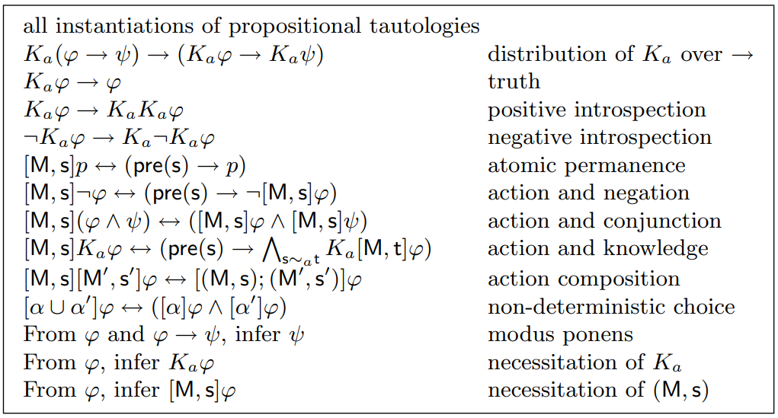
The proof system AM

Slide 31
Definition 7.37 (Translation):
The translation $t:ℒ_{K⊗}→ℒ_{K}$ is defined as follows:
$$t\left(p\right)=p$$
$$t\left(¬φ\right)=¬t(φ)$$
$t\left(φ∧ψ\right)=$ $t\left(φ)∧t(ψ\right)$
$$t\left(K_{a}φ \right)=K_{a}t\left(φ\right)$$
$$t\left(\left[Μ,s\right]p\right)=t\left(pre\left(s\right)→p\right)$$
$$t\left(\left[Μ,s\right]¬φ\right)=t\left(pre\left(s\right)→¬\left[Μ,s\right]φ\right)$$
$$t\left(\left[Μ,s\right]\left(φ∧ψ\right)\right)=t\left(\left[Μ,s\right]φ∧\left[Μ,s\right]ψ\right)$$
$$t\left(\left[Μ,s\right]K_{a}φ\right)=t\left(pre\left(s\right)→K_{a}\left[Μ,s\right]φ\right)$$
$$t\left(\left[Μ,s\right]\left[Μ′,s′\right]φ\right)=t\left(\left[Μ,s;Μ′,s′\right]φ\right)$$
$$t\left(\left[α∪α′\right]φ\right)=t\left(\left[α\right]φ\right)∧t\left(\left[α′\right]φ\right)$$

Slide 32
Definition 7.38 (Complexity):
The complexity $c :ℒ_{K⨂}→ℕ$ is defined as follows:
$$c\left(p\right)=1$$
$$c\left(¬φ\right)=1+c\left(φ\right)$$
$c\left(φ∧ψ\right)=1+\max_{}\left(c\left(φ\right),c\left(ψ\right)\right)$
$$c\left(K_{a}φ\right)=1+c\left(φ\right)$$
$$c\left(\left[α\right]φ\right)=\left(4+c\left(α\right)\right)∙c\left(φ\right)$$
$$c\left([Μ,s]\right)=\max_{}\left\{c\left(pre\left(t\right)\right)|t∈Μ\right\}$$
$$c\left([α∪α^{′}]\right)=1+\max_{}\left(c\left(α\right),c\left(α′\right)\right)$$

Slide 33
Lemma 7.39:
For all $φ,ψ$ and $χ$:
$c\left(ψ\right)≥c\left(φ\right)$ if $φ∈Sub\left(ψ\right)$
$c\left(\left[Μ,s\right]p\right)>c\left(pre\left(s\right)→p\right)$
$c\left(\left[Μ,s\right]¬φ\right)>c\left(pre\left(s\right)→¬\left[Μ,s\right]φ\right)$
$c\left(\left[Μ,s\right]\left(φ∧ψ\right)\right)>c\left(\left[Μ,s\right]φ∧\left[Μ,s\right]ψ\right)$
$c\left(\left[Μ,s\right]K_{a}φ\right)>c\left(pre\left(s\right)→K_{a}\left[Μ,s\right]φ\right)$
$c\left(\left[Μ,s\right]\left[Μ′,s′\right]φ\right)>c\left(\left[Μ,s;Μ′,s′\right]φ\right)$
$c\left(\left[α∪α′\right]φ\right)>c\left(\left[α\right]φ∧\left[α′\right]φ \right)$

Slide 34
Lemma 7.40:
For all formulas ${φ∈ℒ}_{K⨂}$ it is the case that
$⊢φ↔t\left(φ\right)$
(i.e. every formula is provably equivalent to its translation)
Proof:
Is similar to the proof of Lemma 7.24
Theorem 7.41 (Completeness):
For every ${φ∈ℒ}_{K⊗}$ $⊨φ$ implies $⊢φ$
Proof:
Suppose that $⊨φ$ . Therefore $⊨t\left(φ\right)$ (by the soundness) and by Lemma 7.40 holds that $⊢φ↔t\left(φ\right)$. Because of the fact that $t\left(φ\right)$ doesn’t contain any action models, $S5⊢t\left(φ\right)$ (Theorem 7.7) We also have that $AM⊢t\left(φ\right)$ as $S5$ is subsystem of $AM$. Since $AM⊢φ↔t\left(φ\right)$, it follows that $AM⊢φ$.


Slide 35
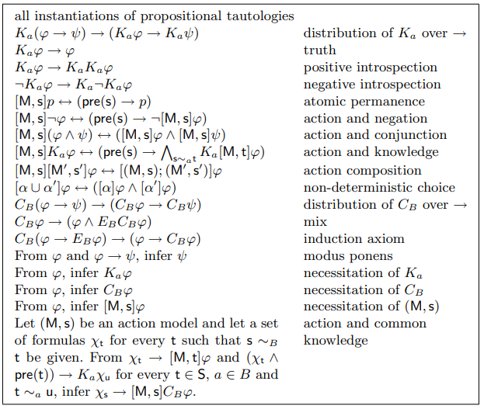
The proof system AMC

Slide 36
Definition 7.42 (Closure):
Let $cl:ℒ_{KC⨂}→℘\left(ℒ_{KC⨂}\right)$, be the function such that for every ${φ∈ℒ}_{KC⨂}$, $cl\left(φ\right)$ is the smallest set such that:
$φ∈cl(φ)$,
If $ψ∈cl(φ)$, then $Sub(ψ)⊆cl(φ)$ (where $Sub(ψ)$ is the set of subformulas of $ψ$),
If $ψ∈cl\left(φ\right)$ and $ψ$ is not a negation, then $¬ψ∈cl(φ)$,
If $C_{B}ψ∈cl\left(φ\right)$, then$\left\{K_{a}C_{B}ψ|a∈B\right\}⊆cl\left(φ\right)$,
If $\left[Μ,s\right]p∈cl\left(φ\right)\text{, }\text{then}$ $\left(pre\left(s\right)→p\right)∈cl\left(φ\right)$,
If $\left(\left[Μ,s\right]¬ψ\right)∈cl\left(φ\right)\text{, }\text{then}\left(pre\left(s\right)→¬\left[Μ,s\right]ψ\right)∈cl\left(φ\right)\text{,}$
If $\left[Μ,s\right]\left(ψ∧χ\right)∈cl\left(φ\right)\text{, }\text{then}$ $\left(\left[Μ,s\right]ψ∧\left[Μ,s\right]χ\right)∈cl\left(φ\right)\text{,}$
If $\left[Μ,s\right]K_{a}φ∈cl\left(φ\right) \text{and} \text{s}\sim _{α}t,$ then $\left(pre\left(s\right)→K_{a}\left[Μ,s\right]φ\right)∈cl\left(φ\right)\text{,}$
If $\left[Μ,s\right]C_{B}ψ∈cl\left(φ\right),$ then $\left\{\left[Μ,t\right]ψ| \text{s}\sim _{B}t\right\}⊆cl\left(φ\right)$ and $\left\{K_{a}\left[Μ,t\right]C_{B}ψ|a∈B and\text{s}\sim _{B}t\right\}⊆cl\left(φ\right)$,
If $\left[Μ,s\right]\left[Μ′,s′\right]ψ∈cl\left(φ\right), \text{then}$ $\left[Μ,s;Μ′,s′\right]ψ∈cl\left(φ\right)$,
if $\left[α∪α′\right]ψ∈cl\left(φ\right), \text{then}$ $\left(\left[α\right]ψ∧\left[α′\right]\text{ψ} \right)∈cl\left(φ\right)$,

Slide 37
Lemma 7.43:
$cl\left(φ\right)$ is finite for all formulas ${φ∈ℒ}_{KC⨂}$.
Lemma 7.44 (Lindenbaum):
Let $Φ$ be the closure of some formula. Every consistent subset of $Φ$ is a subset of a maximal consistent set in $Φ$.
Proof:
The same as Lemma 7.12
Definition 7.45 ($BM$st-path):
A $BM$st-path from $Γ$ is a $B$-path $Γ_{0},…,Γ_{n}$ from $Γ$ such that there is a $B$-path $s_{0},…,s_{n}$ from $s$ to $t$ in $M$ and for all $k<n$ there is an agent $a∈B$ such that $Γ_{k}∼_{a}^{c}Γ_{k+1}$ and $s_{k}∼_{a}^{}s_{k+1}$ and for all $k≤n$ it is the case that $pre\left(s_{k}\right)∈Γ_{k}$.

Slide 38
Lemma 7.46:
Let $Φ$ be the closure of some formula. Let $M^{c}=\left(S^{c},∼^{c},V^{c}\right)$ be the canonical model for $Φ$. If $Γ$ and $Δ$ are maximal consistent sets, then:
$Γ$ is deductively closed in $Φ$
If $¬φ∈Φ$, then $φ∈Γ$ iff $¬φ∉Γ$
If $\left(φ∧ψ\right)∈Φ$, then $\left(φ∧ψ\right)∈Γ$ iff $φ∈Γ$ and $ψ∈Γ$
If $\underline{Γ}∧\hat{K_{a}}\underline{Δ}$ is consistent, then $Γ∼_{a}^{c}Δ$
If $K_{a}ψ∈Φ$, then $\left\{K_{a}φ|K_{a}φ∈Γ\right\}⊢ψ$iff $\left\{K_{a}φ|K_{a}φ∈Γ\right\}⊢K_{a}ψ$
If${ C}_{B}φ∈Φ$, then ${ C}_{B}φ∈Γ$ iff every B-path from $Γ$ is a $φ$-path.
If $\left[Μ,s\right]C_{B}φ∈Φ\text{, }\text{then} { \left[Μ,s\right]C}_{B}φ∈Γ \text{iff} \text{for} \text{all} \text{t}∈\text{S} \text{every} \text{BMst}\text{−}\text{path} \text{from} Γ \text{ends} \text{in} \text{a} \left[Μ,t\right]\text{φ}\text{−}\text{state}\text{.}$

Slide 39
Definition 7.47 (Complexity):
The complexity $c :ℒ_{KC⨂}→ℕ$ is defined as follows:
$$c\left(p\right)=1$$
$$c\left(¬φ\right)=1+c\left(φ\right)$$
$c\left(φ∧ψ\right)=1+\max_{}\left(c\left(φ\right),c\left(ψ\right)\right)$
$$c\left(K_{a}φ\right)=1+c\left(φ\right)$$
$$c\left(C_{B}φ\right)=1+c\left(φ\right)$$
$$c\left(\left[α\right]φ\right)=\left(4+c\left(α\right)\right)∙c\left(φ\right)$$
$$c\left([Μ,s]\right)=\max_{}\left\{c\left(pre\left(t\right)\right)|t∈Μ\right\}$$
$$c\left([α∪α^{′}]\right)=1+\max_{}\left(c\left(α\right),c\left(α′\right)\right)$$
Lemma 7.48:
For all $φ,ψ$ and $χ$:
$c\left(ψ\right)≥c\left(φ\right)$ for all $φ∈Sub\left(ψ\right)$
$c\left(\left[Μ,s\right]p\right)>c\left(pre\left(s\right)→p\right)$
$c\left(\left[Μ,s\right]¬φ\right)>c\left(pre\left(s\right)→¬\left[Μ,s\right]φ\right)$
$c\left(\left[Μ,s\right]\left(φ∧ψ\right)\right)>c\left(\left[Μ,s\right]φ∧\left[Μ,s\right]ψ\right)$
$c\left(\left[Μ,s\right]K_{a}φ\right)>c\left(pre\left(s\right)→K_{a}\left[Μ,t\right]φ\right)$ for all $t∈Μ$
$c\left(\left[Μ,s\right]C_{B}φ\right)>c\left(\left[Μ,t\right]φ\right)$ for all $t∈Μ$
$c\left(\left[Μ,s\right]\left[Μ′,s′\right]φ\right)>c\left(\left[\left(Μ,s\right);\left(Μ′,s′\right)\right]φ\right)$
$c\left(\left[α∪α′\right]φ\right)>c\left(\left[α\right]φ∧\left[α′\right]φ \right)$

Slide 40
Lemma 7.50 (Truth):
Let $Φ$ be the closure of some formula. Let $M^{c}=\left(S^{c},∼^{c},V^{c}\right)$ be the canonical model for $Φ$. For all $Γ∈S^{c}$ and all $φ∈Φ$:
$φ∈Γ$ iff $\left(M^{c},Γ\right)⊨φ$
Proof: (by induction on $c\left(φ\right)$)
Suppose that $φ∈Φ$.
Base case: Suppose that $φ$ is a propositional variable $p$. Then by the definition of $V^{c}$, $p∈Γ$ iff $Γ∈S^{c}$ which by semantics is equivalent to $\left(M^{c},Γ\right)⊨p$.
Induction hypothesis: For all $φ$ such that $c\left(φ\right)≤n:$
$φ∈Γ \text{iff} \left(M^{c},Γ\right)⊨φ$.
Induction step: Suppose that $c\left(φ\right)=n+1$. The cases for $¬, ∧,$ $K_{a}$, $C_{B}$ are just like Lemma 7.17.
The case for $\left[Μ,s\right]p$: Suppose that $\left[Μ,s\right]p∈Γ$. Given that$\left[Μ,s\right]p∈Φ$,$\left[Μ,s\right]p∈Γ$ is equivalent to $\left(pre\left(s\right)→p\right)$ by the atomic permanence axiom. By item 2 of Lemma 7.48, we can apply the induction hypothesis. Therefore this is equivalent to
$\left(M^{c},Γ\right)⊨\left(pre\left(s\right)→p\right)$ which is equivalent by semantics to $\left(M^{c},Γ\right)⊨\left[Μ,s\right]p$.
The case for $\left[Μ,s\right]¬χ$: Suppose that $\left[Μ,s\right]¬χ∈Γ$. Given that$\left[Μ,s\right]¬χ∈Φ$, $\left[Μ,s\right]¬χ∈Γ$ is equivalent to $\left(pre\left(s\right)→¬\left[Μ,s\right]χ\right)∈Γ$ by the action and negation axiom. By item 3 of Lemma 7.48, we can apply the induction hypothesis. Therefore this is equivalent to
$\left(M^{c},Γ\right)⊨pre\left(s\right)→¬\left[Μ,s\right]χ$which is equivalent by semantics to $\left(M^{c},Γ\right)⊨\left[Μ,s\right]¬χ$.

Slide 41
The case for$\left[Μ,s\right]\left(χ∧ξ\right)$: Suppose that$\left[Μ,s\right]\left(χ∧ξ\right)∈Γ$. Given that$\left[Μ,s\right]\left(χ∧ξ\right)∈Φ$,$\left[Μ,s\right]\left(χ∧ξ\right)∈Γ$ is equivalent to $\left(\left[Μ,s\right]χ∧\left[Μ,s\right]ξ\right)∈Γ$ by the action and conjunction axiom. By item 4 of Lemma 7.48, we can apply the induction hypothesis. Therefore this is equivalent to $\left(M^{c},Γ\right)⊨\left[Μ,s\right]χ∧\left[Μ,s\right]ξ$ which is equivalent by semantics to $\left(M^{c},Γ\right)⊨\left[Μ,s\right]\left(χ∧ξ\right)\text{.}$
The case $\left[Μ,s\right]K_{a}χ$: Suppose that $\left[Μ,s\right]K_{a}χ∈Γ$. Given that$\left[Μ,s\right]K_{a}χ∈Φ$,$\left[Μ,s\right]K_{a}χ∈Γ$ is equivalent to $\left(pre\left(s\right)→K_{a}\left[Μ,t\right]χ\right)∈Γ$for all $t∈Μ$by the action and knowledge axiom. By item 5 of Lemma 7.48, we can apply the induction hypothesis. Therefore this is equivalent to $\left(M^{c},Γ\right)⊨pre\left(s\right)→K_{a}\left[Μ,t\right]χ$ which is equivalent by semantics to $\left(M^{c},Γ\right)⊨\left[Μ,s\right]K_{a}χ$.
The case for $\left[Μ,s\right]\left[Μ′,s′\right]ξ$: Suppose that$\left[Μ,s\right]\left[Μ′,s′\right]ξ∈Γ$. Given that$\left[Μ,s\right]\left[Μ′,s′\right]ξ∈Φ$,$\left[Μ,s\right]\left[Μ′,s′\right]ξ∈Γ$ is equivalent to$\left[Μ,s;Μ′,s′\right]ξ∈Γ$ by the action and composition axiom. By item 7 of Lemma 7.48, we can apply the induction hypothesis. Therefore this is equivalent to $\left(M^{c},Γ\right)⊨\left[Μ,s;Μ′,s′\right]ξ$which is equivalent by semantics to
$\left(M^{c},Γ\right)⊨\left[Μ,s\right]\left[Μ′,s′\right]ξ$.
The case for $\left[α∪α′\right]ξ$: Suppose that$\left[α∪α′\right]ξ∈Γ$. Given that$\left[α∪α′\right]ξ∈Φ$,$\left[α∪α′\right]ξ∈Γ$ is equivalent to$\left[α\right]ξ∧\left[α′\right]ξ∈Γ$ by the non-deterministic choice axiom. By item 8 of Lemma 7.48, we can apply the induction hypothesis. Therefore this is equivalent to $\left(M^{c},Γ\right)⊨\left[α\right]ξ∧\left[α′\right]ξ$ which is equivalent by semantics to
$\left(M^{c},Γ\right)⊨\left[α∪α′\right]ξ$.


Slide 42
Lemma 7.51 (Canonicity):
The canonical model is reflexive, transitive and Euclidean.
Theorem 7.52 (Completeness) :
For every ${φ∈ℒ}_{KC⨂}$
$⊨φ$ implies $⊢φ$
Proof:
We will prove this theorem by contraposition. Thus we suppose that $⊬φ$. Therefore $\left\{¬φ\right\}$ is a consistent set. By the Lindenbaum Lemma $\left\{¬φ\right\}$ is a subset of some $Γ$ which is maximal consistent in $cl\left(¬φ\right)$. Let $M^{c}$ be the canonical model for $cl\left(¬φ\right)$. By the Truth Lemma $\left(M^{c},Γ\right)⊨¬φ$. Therefore ⊭$φ$. 

Slide 43
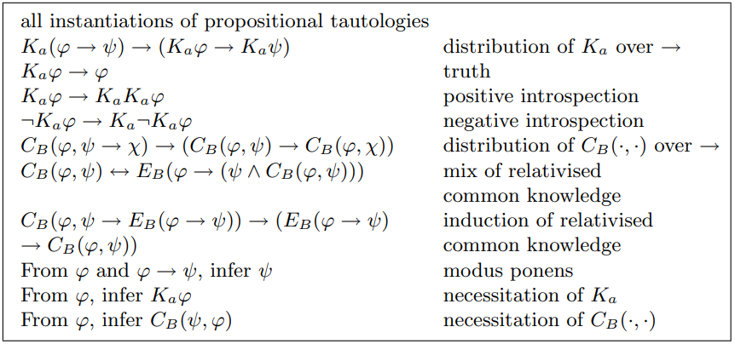
The proof system S5RC

Slide 44
Definition 7.53:
Given are a set of agents $A$ and a set of atoms $P$. The language $ℒ_{KRC}$consists of all formulas given by the following BNF:
$$φ∷=p\left| ¬φ \right| \left(φ∧φ\right) \left| K_{α}φ \right| C_{B}\left(φ,φ\right)$$
Where $p∈P,a∈A and B⊆A$.
Definition 7.54(Semantics):
Given is an epistemic model $M=\left\langle S,\sim ,V\right\rangle$. The semantics for atoms, negations, conjunctions and individuals operators are as usual.
$\left(Μ,s\right)⊨C_{B}\left(φ,ψ\right)$ iff $\left(Μ,s\right)⊨ψ$ for all $t$ such that $\left(s,t\right)∈{\left(\bigcup_{a∈B}{\sim _{a}∩\left(S×{⟦φ⟧}_{M}\right)}\right)}^{+}$
$${\left(\bigcup_{a∈B}{\sim _{a}∩\left(S×{⟦φ⟧}_{M}\right)}\right)}^{+}$$
is the transitive closure

Slide 45
Theorem 7.56:
The proof system S5RC is sound , i.e., if $⊢φ$, then $⊨φ$
Definition 7.58 (Closure):
Let $cl:ℒ_{KRC}→℘\left(ℒ_{KRC}\right)$, be the function such that for every ${φ∈ℒ}_{KRC}$, $cl\left(φ\right)$ is the smallest set such that:
$φ∈cl(φ)$,
If $ψ∈cl(φ)$, then $Sub(ψ)⊆cl(φ)$ (where $Sub(ψ)$ is the set of subformulas of $ψ$),
If $ψ∈cl\left(φ\right)$ and $ψ$ is not a negation, then $¬ψ∈cl(φ)$,
If$C_{B}\left(ψ,χ\right)∈cl\left(φ\right)$, then$\left\{K_{a}\left(ψ→\left(χ∧C_{B}\left(ψ,χ\right)\right)\right)|a∈B\right\}⊆cl\left(φ\right)$
Lemma 7.59:
$cl\left(φ\right)$ is finite for all formulas ${φ∈ℒ}_{KRC}$.

Slide 46
Lemma 7.60:
Let $Φ$ be the closure of some formula. Let $M^{c}=\left(S^{c},∼^{c},V^{c}\right)$ be the canonical model for $Φ$. Let $Γ$ be maximal consistent set in $Φ$. If $C_{B}\left(φ,ψ\right)∈Φ$, then $C_{B}\left(φ,ψ\right)∈Γ$ iff every $B$-$φ$-path from a $Δ∈S^{c}$ such that there is an agent $a∈B$ and $Γ∼_{a}^{c}Δ$is a $ψ$-path.
Lemma 7.61 (Truth):
Let $Φ$ be the closure of some formula. Let $M^{c}=\left(S^{c},∼^{c},V^{c}\right)$ be the canonical model for $Φ$. For all $Γ∈S^{c}$ and all $φ∈Φ$:
$φ∈Γ$ iff $\left(M^{c},Γ\right)⊨φ$
Proof : Suppose $φ∈Φ$. We will prove this Lemma by induction on $φ$. We focus on the case for relativised common knowledge due to the fact that the other cases are the same as in proof of Lemma 7.17.

Slide 47
The case for $C_{B}\left(φ,ψ\right)$: Suppose that $C_{B}\left(φ,ψ\right)∈Γ$.
From the Lemma 7.60 this is the case iff every $B$-$φ$-path from a $Δ∈S^{c}$ such that there is an agent $a∈B$ and $Γ∼_{a}^{c}Δ$is a $ψ$-path. By induction hypothesis this is the case iff every $B$-path where $φ$ is true along the path, is a path along which $ψ$ is true. By semantics this is equivalent to $\left(M^{c},Γ\right)⊨C_{B}\left(φ,ψ\right)$.

Slide 48
Theorem 7.62 (Completeness) :
For every ${φ∈ℒ}_{KRC}$
$⊨φ$ implies $⊢φ$
Proof:
We will prove this theorem by contraposition. Thus we suppose that $⊬φ$. Therefore $\left\{¬φ\right\}$ is a consistent set. By the Lindenbaum Lemma $\left\{¬φ\right\}$ is a subset of some $Γ$ which is maximal consistent in $cl\left(¬φ\right)$. Let $M^{c}$ be the canonical model for $cl\left(¬φ\right)$. By the Truth Lemma $\left(M^{c},Γ\right)⊨¬φ$. Therefore ⊭$φ$. 

Slide 49
The proof system PARC

Slide 50
Definition 7.63:
Given are a set of agents $A$ and a set of atoms $P$. The language $ℒ_{KRC[]}$consists of all formulas given by the following BNF:
$$φ∷=p\left| ¬φ \right| \left(φ∧φ\right) \left| K_{α}φ \right| C_{B}\left(φ,φ\right) | \left[φ\right]φ$$
Where $p∈P,a∈A and B⊆A$.
Lemma 7.65:
$$⊨\left[φ\right]C_{a}\left(ψ,χ\right)↔φ→C_{a}\left(φ∧\left[φ\right]ψ,\left[φ\right]χ\right)$$

Slide 51
Definition 7.66 (Translation):
The translation $t:ℒ_{KRC[]}→ℒ_{KRC}$ is defined as follows:
$$t\left(p\right)=p$$
$$t\left(¬φ\right)=¬t\left(φ\right)$$
$t\left(φ∧ψ\right)=$ $t\left(φ)∧t(ψ\right)$
$$t\left(K_{a}φ \right)=K_{a}t\left(φ\right)$$
$$t\left(\left[φ\right]p\right)=t\left(φ→p\right)$$
$$t\left(\left[φ\right]¬ψ\right)=t\left(φ→¬\left[φ\right]ψ\right)$$
$$t\left(\left[φ\right]\left(ψ∧χ\right)\right)=t\left(\left[φ\right]\left(ψ)∧\left[φ\right]χ\right)\right)$$
$$t\left(\left[φ\right]K_{a}ψ\right)=t\left(φ→K_{a}\left[φ\right]ψ\right)$$
$$t\left(\left[φ\right]C_{a}\left(ψ,χ\right)\right)=t\left(φ→C_{a}\left(φ∧\left[φ\right]ψ,\left[φ\right]χ\right)\right)$$
$$t\left(\left[φ\right]\left[ψ\right]χ\right)=t\left(\left[φ∧\left[φ\right]ψ\right]χ\right)$$
Definition 7.67 (Complexity):
The complexity $c :ℒ_{KRC[]}→ℕ$ is defined as follows:
$$c\left(p\right)=1$$
$$c\left(¬φ\right)=1+c\left(φ\right)$$
$c\left(φ∧ψ\right)=1+\max_{}\left(c\left(φ\right),c\left(ψ\right)\right)$
$$c\left(K_{a}φ\right)=1+c\left(φ\right)$$
$$c\left(C_{B}\left(φ,ψ\right)\right)=1+\max_{}\left(c\left(φ\right),c\left(ψ\right)\right)$$
$$c\left(\left[φ\right]ψ\right)=\left(5+c\left(φ\right)\right)∙c\left(ψ\right)$$

Slide 52
Lemma 7.68:
For all $φ,ψ$ and $χ$:
$c\left(ψ\right)≥c\left(φ\right)$ if $φ∈Sub\left(ψ\right)$
$c\left(\left[φ\right]p\right)>c\left(φ→p\right)$
$c\left(\left[φ\right]¬ψ\right)>c\left(φ→¬\left[φ\right]ψ\right)$
$c\left(\left[φ\right]\left(ψ∧χ\right)\right)>c\left(\left[φ\right]ψ∧\left[φ\right]χ\right)$
$c\left(\left[φ\right]K_{a}ψ\right)>c\left(φ→K_{a}\left[φ\right]ψ\right)$
$c\left(\left[φ\right]C_{B}\left(ψ,χ\right)\right)>c\left(φ→C_{B}\left(φ∧\left[φ\right]ψ,\left[φ\right]χ\right)\right)$
$c\left(\left[φ\right]\left[ψ\right]χ\right)>c\left(\left[φ∧\left[φ\right]ψ\right]χ\right)$

Slide 53
Proof:
$$c\left(\left[φ\right]C_{B}\left(ψ,χ\right)\right)>c\left(φ→C_{B}\left(φ∧\left[φ\right]ψ,\left[φ\right]χ\right)\right)$$
Assume without loss of generality, that $c\left(ψ\right)≥c\left(χ\right)$. Then :
$$c\left(\left[φ\right]C_{B}\left(ψ,χ\right)\right)=\left(5+c\left(φ\right)\right)\left(1+\max_{}\left(c\left(ψ\right),c\left(χ\right)\right)\right)$$
$$=5+c\left(φ\right)+5\max_{}\left(c\left(ψ\right),c\left(χ\right)\right)+c\left(φ\right)\max_{}\left(c\left(ψ\right),c\left(χ\right)\right)$$
$=$ $5+c\left(φ\right)+5c\left(ψ\right)+c\left(φ\right)c\left(ψ\right)$
And
$$c\left(φ→C_{B}\left(φ∧\left[φ\right]ψ,\left[φ\right]χ\right)\right)=c\left(¬\left(φ∧¬C_{B}\left(φ∧\left[φ\right]ψ,\left[φ\right]χ\right)\right)\right)$$
$$=2+$$
$$\max_{}\left(c\left(φ\right),1+1+\max_{}\left(1+\max_{}\left(c\left(φ\right),\left(5+c\left(φ\right)\right)c\left(ψ\right)\right),\left(5+c\left(φ\right)\right)c\left(χ\right)\right)\right)$$
$$=5+\left(\left(5+c\left(φ\right)\right)c\left(ψ\right)\right)$$
$=5+5$ $c\left(ψ\right)$+ $c\left(φ\right)$ $c\left(ψ\right)$

Slide 54
Lemma 7.69:
For all formulas ${φ∈ℒ}_{KRC[]}$ it is the case that
$⊢φ↔t\left(φ\right)$
Proof:
Is similar to the proof of Lemma 7.24
Theorem 7.70 (Completeness):
For every ${φ∈ℒ}_{KRC[]}$ $⊨φ$ implies $⊢φ$
Proof:
Suppose that $⊨φ$ . Therefore $⊨t\left(φ\right)$ (by the soundness) and by Lemma 7.69 holds that $⊢φ↔t\left(φ\right)$. Because of the fact that $t\left(φ\right)$ doesn’t contain any announcement operators, $S5RC⊢t\left(φ\right)$ (Theorem 7.62) We also have that $PARC⊢t\left(φ\right)$ as $S5RC$ is subsystem of $PARC$. Since $PARC⊢φ↔t\left(φ\right)$, it follows that $PARC⊢φ$.


