Slide 1
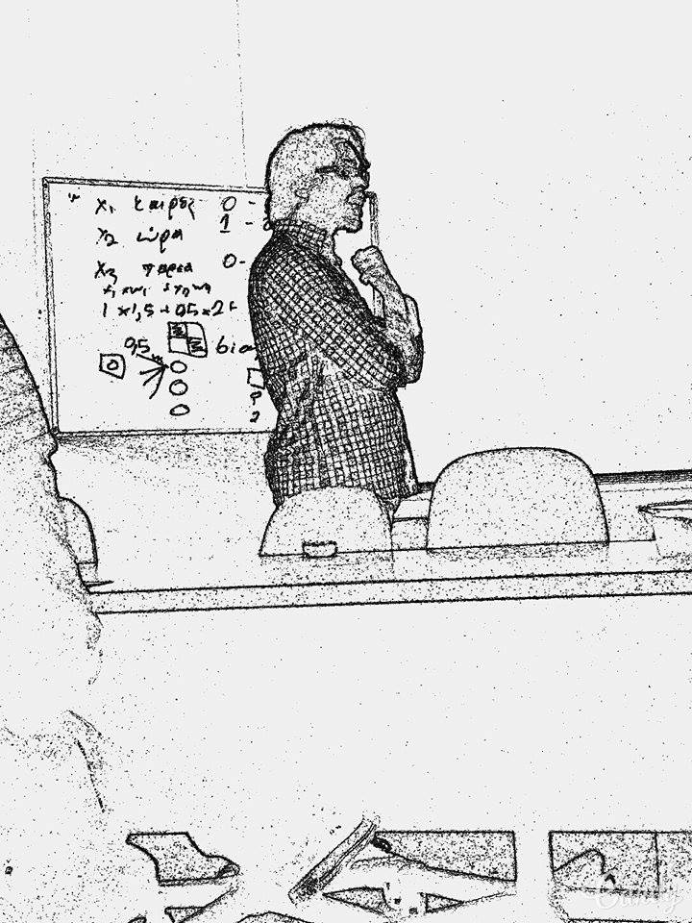
Machine Learning Artificial Neural Networks
MPλ∀
Stergiou Theodoros

Slide 2
What are ANNs
"...a computing system made up of a number of simple, highly interconnected processing elements, which process information by their dynamic state response to external inputs.” M. Caudill 1989
Computational model based on the structure and functions of biological Neural Networks
They are considered nonlinear statistical data modeling tools where the complex relationships between inputs and outputs are modeled or patterns are found

Slide 3
Example of ANN
Digit recognition ANN, can be used in post office for automated recognition of zip codes.
The neural network is trained by thousands of pictures of digits
The network is presented a digit that has not been used in the training and it is classified.
Best commercial neural networks get over 99% accuracy

Slide 4
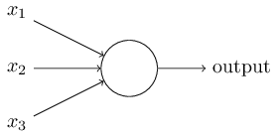
What is a NN? Perceptron
x₁, x₂, x₃ inputs
w₁, w₂, w₃ weights
b bias
Wanna go for a
cup of coffee?

Slide 5
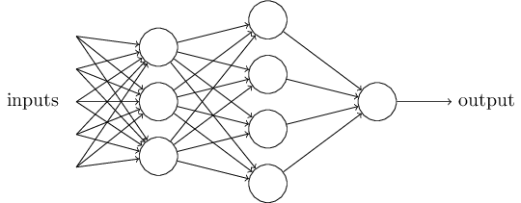
Perceptron NN
As a single perceptron can make a decision based on some inputs and some weights, a combination of perceptrons can make more complicated decisions

Slide 6
Perceptron NN-Why is it bad?
When we train a NN we repeatedly adjust the weights so that the output becomes the desired (supervised learning techniques), a process called backpropagation.
A small change in weights can cause the output to completely flip state changing drastically the outcome of the NN.

Slide 7
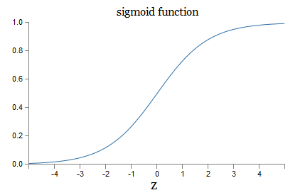
Sigmoid Neurons
Similar with perceptrons, but modified so that a small change in the weights, can cause a small change in the output.
The output is a value from
0 to 1, instead of 0 or 1.
Sigmoid function σ(z)

Slide 8
Digit recognition example(1)
Problem: Create a program that classifies numbers from 0 to 9
Inputs: Numbers from 0 to 9, as 28x28 pixel images = 784 Inputs with values of 0 to 1, representing the gray scale of each pixel.
Second Layer (Hidden Layer): 15 neurons
Output Layer: 10 neurons. If the first neuron fires, then the input has been identified as a 0, if the second, then as a 1 and so on…

Slide 9
Digit recognition example(2)

Slide 10
Digit recognition example(3)
Which pixel from the input digit was important for the output?
After the correct or incorrect classification of the digit, the weights of the neural network are slightly changed through backpropagation.
Thousands of digits pass through the ANN, each changing the weights accordingly.

Slide 11
Digit recognition example(4)
The core of the system is the weight vector that was created by backpropagation. After the training the weight vector is what will classify the new inputs.
The initial weights could even be completely random this way.

Slide 12
Digit recognition example(5)
Input 50,000 predetermined digit images 28x28 from 250 test subjects as training set
Input 10,000 predetermined digit images from the same 250 test sujects as validation set
Input another 10,000 from 250 different people as test set
Win – ~95% classification accuracy

Slide 13
Important Aspects of ANNs(1) Cost Function
The cost function quantifies how well we are achieving the weight optimization
x is the input
y(x) is the vector of desired output
w denotes the collection of all weights in the network
b are all the biases
n is the total number of training inputs
a is the vector of outputs from the network

Slide 14
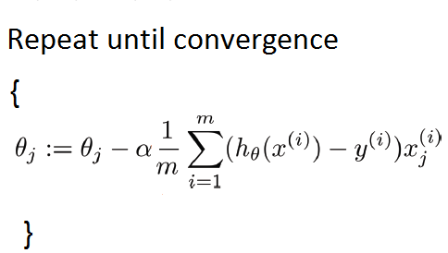
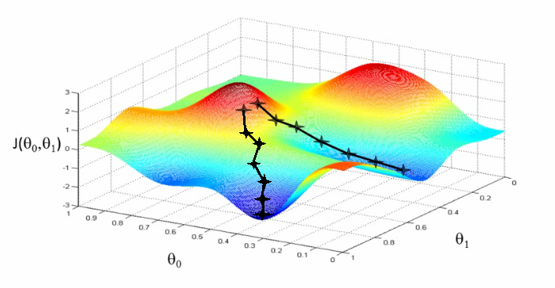
Important Aspects of ANNs(2) Gradient Descent
In order to minimize the Cost Function we use an algorithm known as Gradient Descent.
The algorithm searches for a global minima
A simple visualization for a 2D minimization

Slide 15
Computational Complexity of a NN
Feed forward networks don’t have a stable state of memory capacity. Instead they have input-output relations.
Complexity increases very fast with the depth of the network
Enabling successful training we must consider: the activation function, overspecification (larger NN than the minimum required), regularization of weights

Slide 16
Problems of NN
Overtrain
Bad training set
Curse of dimensionality: Each additional input unit in a network adds another dimension to the space in which the data cases reside
Inter-dependency of variables: It would be extremely useful if each candidate input variable could be independently assessed for usefulness

Slide 17
Variations of Neural Networks
By changing the Sigmoid activation function to another , or optimizing the Cost Function or the Gradient Descent and other techniques we can see a variety of different NN, optimized for different tasks.
Different type of Neural Networks: Radial Basis function, self organizing, Learning Vector Quantization, Recurrent (Fully, Simple, Echo state, Long short term memory, bi-directional, hierarchical, stochastic), Modular…

Slide 18
Sources
Information Theory, Complexity and Neural Networks, Y. Abu-Mostafa, 1989, IEEE, Communications Magazine
On the computational efficiency of Training Neural Networks, R. Livni et al, 2014, Advances of Neural Information Processing Systems
Neural Networks and Deep Learning, M. Nielsen, 2015, available online http://neuralnetworksanddeeplearning.com/index.html
Machine Learning online courses by Andrew Ng, Stanford University, www.coursera.org
Neural Networks online courses by Geoffrey Hinton, University of Toronto, www.coursera.org
https://www.techopedia.com/definition/5967/artificial-neural-network-ann
http://pages.cs.wisc.edu/~bolo/shipyard/neural/local.html

Slide 19
Thank you for your time

